Slide 1
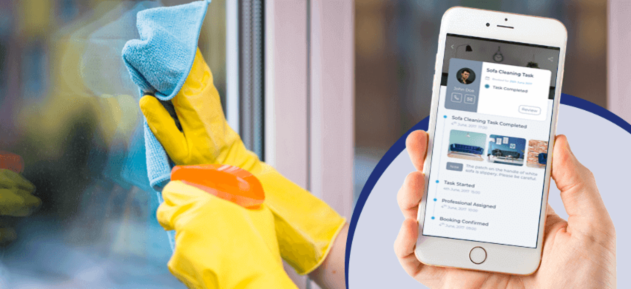
Maid Match
Connecting People with Reliable and Skilled Domestic Workers

Slide 2

Problem statement
Despite the increasing demand for domestic help and household services, there exists a prevalent problem in efficiently and reliably finding qualified maids.
This issue is characterized by a lack of standardized vetting processes, leading to concerns about trustworthiness, reliability, and the overall quality of services provided.
The absence of a streamlined platform or method for connecting households with skilled and trustworthy domestic workers contributes to a persistent challenge in establishing secure and satisfactory arrangements for both service seekers and providers.
Addressing this problem requires a comprehensive solution that addresses the vetting process, communication barriers, and overall transparency in the domestic service industry."
MaidMatch

Slide 3

MaidMatch
Connecting You with Reliable and Skilled Domestic Workers
Welcome to MaidMatch, the revolutionary platform that simplifies the process of hiring reliable domestic workers and maids.
Say goodbye to the hassle of finding trustworthy help.
MaidMatch not only provides a reliable solution for households but also empowers skilled individuals in the domestic service sector.
MaidMatch

Slide 4

Target solution
MaidMatch is a user-friendly platform connecting households with trustworthy domestic workers. It features detailed profiles, advanced matching, secure verification, and transparent pricing. With real-time communication, reviews, and additional resources, MaidMatch creates a reliable community for both users and skilled workers, ensuring continual improvement through feedback.
MaidMatch

Slide 5

solution potential areas
MaidMatch serves households with working parents in need of reliable help.
It assists students in flats with chores and provides support for senior citizens living alone.
The platform caters to busy professionals, individuals with disabilities, and families with young children.
MaidMatch offers a comprehensive solution for various domestic needs.
Whether it's a family home, a student's flat, or an elderly person's residence, MaidMatch simplifies daily life.
MaidMatch

Slide 6
Limitations
Limited Regional Coverage:
MaidMatch may face limitations in certain regions where the platform is not available, restricting access for users in those areas.
Dependence on Internet Connectivity:
Users without consistent internet access may face challenges in utilizing MaidMatch's services, limiting the platform's accessibility.
Trustworthiness Concerns:
Despite verification processes, concerns about the reliability of information provided by domestic workers may still arise, affecting user trust
Cultural and Language Barriers:
Cultural and language differences may impact the effectiveness of communication between users and maids, potentially leading to misunderstandings.
MaidMatch

Slide 7
MaidMatch
Team maidmatch
25/11/23
1.0
Background checks, references, and identity verification.
Regular updates of worker profiles based on performance.
Seasonal promotions and discounts to attract new users.
Quick and easy registration for both users and domestic workers.
Intuitive search and filter options for specific services and skills.
Verification process ensures skilled and reliable domestic workers.
Diverse services offered, including house cleaning, child care, elder care, and pet care.
User reviews and ratings for each domestic worker.
Transparent pricing and service details.
24/7 helpline for immediate assistance.
Live chat support on the website/app.
In-app feedback forms.
Regular surveys and incentives for users to provide feedback.
Individuals:
Homeowners
Busy professionals
Families with young children or elderly members
Businesses:
Small and medium-sized enterprises
Corporate offices
Healthcare facilities requiring eldercare services
Domestic Worker Associations.
Background Check and Verification Services.
Digital Platforms and Influencers.
Government Agencies.
Insurance Providers.
Technology Partners.
Skilled development team
Regular updates
Recruitment team
Training programs.
Well-trained support staff
Online Platform:
Websites.
Mobile application.
Social media advertising.
Collaborations with lifestyle bloggers or influencers.
Initial development costs and ongoing maintenance expenses.
Security measures to protect user data.
Digital marketing campaigns.
Offline advertising in local community spaces.
Fees associated with background checks and verification services.
Tiered subscription plans offering different levels of access and features.
Premium subscriptions for businesses with multiple hiring needs.
Small percentage commission for each successful transaction.
Featured listings for domestic workers could be a premium service.

Slide 8


Value Proposition Canvas
Gains
Gain Creators
Diverse Opportunities
Transparent Communication
Professional Development
Clients:
Access to a pool of skilled maids.
Confidence in the reliability of hired help.
Time and effort savings
Product
and Service Features
Maids:
Increased visibility and access to job opportunities.
Assurance of fair and transparent working conditions.
Customer Jobs
User Profiles
Search and Filter Mechanism
Reviews and Ratings
Messaging and Communication
Background Checks
Payment Integration:
Clients:
Find a maid quickly.
Ensure a seamless hiring process.
Maids:
Find suitable job opportunities
Connect with clients
Secure flexible and fair employment terms.
Pains
Clients:
Lack of trust in the hiring process.
Concerns about the reliability
Pain Relievers
Trust Building Measures
Advanced Filtering
Transparent Reviews
Secure Payment System
Maids:
Limited access to job opportunities.
Inconsistent or unclear payment terms.
MaidMatch

Slide 9
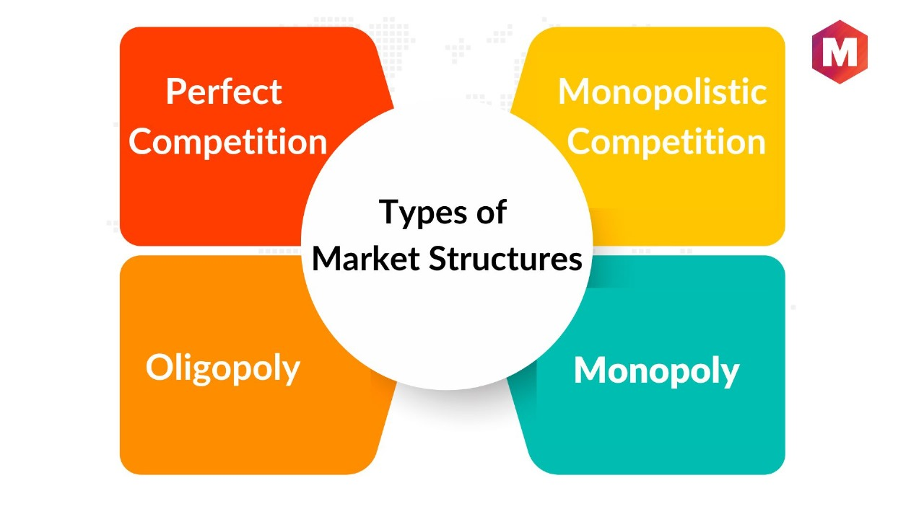
Market Structure
MaidMatch

Slide 10
Market Structure
The market structure for the MaidMatch project aligns most closely with a monopolistic competition model
Many Sellers:
In the case of MaidMatch, there are few websites available offering househelp services.
Product Differentiation:
MaidMatch allows maids to create profiles highlighting their individual skills, experiences, and preferences. This creates product differentiation, as clients can choose a maid based on specific criteria, such as skills or availability.
Ease of Entry and Exit:
The entry and exit of product in market as it’s a online platform.
Independent Decision-Making:
Both clients and maids make independent decisions in this market. Clients can choose from a variety of maids based on their preferences, and maids can select job opportunities that align with their skills and schedules.
Information Availability:
MaidMatch provides information to both clients and maids through detailed profiles, reviews, and ratings. This transparency enhances the flow of information in the market, helping both parties make informed decisions.
Limited Pricing Power:
While clients and maids have some influence over pricing (in negotiation), there is a limit to their pricing power. It have some guidelines to ensure fair compensation, preventing extreme pricing fluctuations.

Slide 11
SWOT analysis
S
Diverse User Base
W
Dependence on User Input
T
Legal and Regulatory Challenges
O
Expansion of Service
User-Friendly Interface
Security Measures
Review and Rating System
Responsive Design
Geographical Limitation
Competition
Dependence on Technology
Partnerships with Agencies
Localized Marketing
Integration with Smart Home Technology
Negative Publicity
Economic Downturn
Technological Risks
STRENGTHS
WEAKNESS
OPPORTUNITIES
STRENGTH
MaidMatch

Slide 12

Financial Projections
Below is a simplified example of the financial projections, considering revenue streams, expenses, and growth assumptions over a three-year period
User Growth
Revenue Model
Subscription Fee
Transaction Fee
MaidMatch

Slide 13
Cost Analysis
1. | Technology Development and Maintenance
1. A | Initial Development year 1
 |  | Website/App Development | Hiring developers, designers, and UX/UI experts for the initial platform creation. | 3,00,000
 |  | Server Setup | Procuring and setting up servers to host the platform. | 2,00,000
 |  | Testing and Quality Assurance | Conducting extensive testing to ensure the platform's functionality, security, and user experience. | 1,50,000
 |  | Mobile App Development | Developing mobile applications for iOS and Android platforms, if part of the strategy. | 2,00,000
1 | Total |  |  | 8,50,000
MaidMatch

Slide 14
1. B | Ongoing Maintenance year 2
 |  | Server Maintenance | Regular maintenance and updates to ensure server performance and security. | 4,00,000
 |  | Bug Fixes and Software Updates | Addressing any bugs or glitches and releasing regular updates to enhance features.. | 3,00,000
 |  | Customer Support System | Implementing and maintaining a customer support system, including hiring support staff if necessary. | 2,00,000
 |  | Technology Upgrades | Investing in technology upgrades to stay current with industry standards and user expectations. | 5,00,000
1 | Total |  |  | 14,00,000
MaidMatch

Slide 15
2. | User Acquisition and Marketing
2. A | Launch and Establish: | Building Maiden Presence
 |  | Digital Advertising | Initiate targeted digital advertising campaigns on social media platform | 4,00,000
 |  | Influencer Collaborations and Content Creation | Partner with influencers, create content, optimize for SE. | 2,00,000
 |  | Launch Events and Partnerships | Organize events, webinars, and build partnerships for community Eng. | 1,00,000
2 | Total |  |  | 7,00,000
2.B | Amplify and Diversify | Scaling Maiden Impact
 |  | Scaling Digital Advertising | Increase budget for larger audience reach and user acquisition. | 5,00,000
 |  | Diversified Influencer Marketing | Expand influencer collaborations, diversify content | 4,00,000
 |  | Promotions and Analytics Tools | Run promotions, invest in analytics for data-driven optimization. | 3,00,000
2. | Total |  |  | 12,00,000
MaidMatch

Slide 16
3. | Administrative and Operational Costs
3 A | Year 1 | Administrative expenses, office space, utilities, operational costs. | 3,00,000
3. B | Year 2 | Scaling operations to accommodate the growing user base. | 4,00,000
Total |  |  | 6,00,000
4. | Legal and Compliance
4 A | Year 1 | Legal consultations, compliance costs, and regulatory expenses. | 1,50,000
4. B | Year 2 | Ongoing legal support and compliance adjustments. | 1,50,000
Total |  |  | 3,00,000
MaidMatch

Slide 17
NO | Amout | Source
 | Rs.
1. | 14,00,000 | Total Capital Required for set up
2. | 6,00,000 | Total Capital Required for initial running up to six months till revenue starts getting generated
Capital required | 20,00,000
Capital Arrangement
3. | 21,00,000 | 3 lakhs from each of us
Capital Arrangement | 21,00,000
Since Capital Required<Capital arrangement , Hence OK.
MaidMatch

Slide 18
Revenue
 | Period | Total Monthly Subscription Revenue | Total Monthly Transaction Revenue | Total Monthly Revenue | Total Yearly Revenue
. | Year 1 | 2,00,000 | 5,000 | 2,05,000 | 24,60,000
 | Year 2 | 4,00,000 | 10,000 | 1,00,000 | 49,20,000
 | Year 3 | 8,00,000 | 20,000 | 8,20,000 | 98,40,000
A | Break Even Analysis if we met the target of 10000 users per year
 | Expense for the first year
 |  | Expenses | Initial cost |  | 14,00,000
 |  | Running | Cost for 1st year |  | 6,00,000
 |  |  |  | Total expense | 20,00,000
 |  | Revenue for 1st year | 2,05,000*12 |  | 24,60,000
 |  |  | Difference |  | 5,00,000
Since difference is positive , Break even will happen in first year only if full target is met
MaidMatch

Slide 19
Technical Risk Analysis
Data Security and Privacy:
Risk: Handling sensitive personal information about both clients and domestic workers poses a significant risk. Security breaches could lead to legal consequences and loss of trust.
Mitigation: Implement robust security measures, encryption protocols, and regular security audits. Comply with data protection regulations (e.g., GDPR) and ensure clear privacy policies.
Platform Reliability:
Risk: Unreliable platform performance or downtime could result in a poor user experience and loss of business.
Mitigation: Invest in reliable hosting, implement redundancy, and perform thorough testing. Have a disaster recovery plan in place to minimize downtime.
User Verification and Background Checks:
Risk: Depending on the accuracy of user-submitted information for domestic workers, there's a risk of false information and potential harm to clients.
Mitigation: Implement a robust verification process, possibly involving background checks and certifications. Provide a system for user reviews to enhance trust.
Integration with Payment Systems:
Risk: If the payment system is not integrated securely, it could lead to financial risks and breaches.
Mitigation: Use reputable payment gateways, implement secure payment protocols, and adhere to industry standards. Regularly update payment-related security measures.
MaidMatch

Slide 20
Market Risk Analysis
Regulatory Changes:
Risk: Changes in labor laws, immigration policies, or other regulations could impact the availability and legality of domestic workers.
Mitigation: Stay informed about regulatory changes, work closely with legal experts, and be prepared to adapt the platform to comply with any new requirements.
Competition:
Risk: The market for domestic worker and maid services may already have established competitors or new entrants that could affect Maidmatch's market share.
Mitigation: Conduct a thorough analysis of competitors, identify unique selling points, and continually innovate to stay ahead. Build strong brand recognition and customer loyalty
Dependency on Online Reviews:
Risk: Over-reliance on online reviews may lead to biased perceptions, and negative reviews could significantly impact the platform's credibility.
Mitigation: Implement a balanced review system, encourage diverse feedback, and actively address concerns raised by users
Economic Conditions:
Risk: Economic factors such as inflation or recession may affect the disposable income of potential customers.
Mitigation: Offer flexible pricing plans, discounts during economic downturns, and explore partnerships to provide value-added services.
MaidMatch

Slide 21
Future Potential
Market Expansion:
As the platform gains traction and establishes itself in its initial target markets, there is potential for geographical expansion into new regions and countries. This could tap into a broader pool of domestic workers and clients.
Diversification of Services:
Maidmatch could explore diversifying its services beyond house cleaning, child care, elder care, and pet care. Additional services like tutoring, home organization, or specialized cleaning services could cater to a wider range of customer needs.
Partnerships and Collaborations:
Forming partnerships with other service providers, such as insurance companies, home security firms, or local businesses, could create value-added offerings for users and expand Maidmatch's ecosystem
Training and Certification Programs:
Offering training and certification programs for domestic workers through the platform could enhance their skills and marketability. This could also establish Maidmatch as a leader in promoting professionalism within the domestic service industry.
Data Analytics for Predictive Matching:
Utilizing advanced data analytics and machine learning for predictive matching could optimize the platform's ability to connect clients with the most suitable domestic workers, improving overall user satisfaction.
MaidMatch

Slide 22

Thank You
Dushant Harinkhede-201070072
Vishwas Hibare-201070067
Kiran Patil -211070904
Mayuresh Murudkar -211070903
Bhavika Purav-211071902
Tejashree Shinde- 211071908
Shrishail Gouragond-211070906
MaidMatch

